Slide 1


Relational Functional Gradient Boosting (RDN & MLN case): A Tutorial
Sriraam Natarajan

Slide 2
Example run instructions
Boost-RDN: java -jar BoostSRLRDN.jar -l -train data/AP_IMDB/train -target female_gender -trees 5 -i -test data/AP_IMDB/test -aucJarPath ./
Boost-MLN: java -jar BoostSRLMLN.jar -l -train data/AP_IMDB/train -target female_gender -trees 5 -i -test data/AP_IMDB/test -aucJarPath ./ -mln
**Example shown for Attribute prediction task using IMDB movie data set.

Slide 3
Tutorial Directory
Data (folder): “./data” – the data for different tasks reside here
Lib (folder): “./lib” – contains all dependencies (jars)
Graphs (folder): “./graphs” – needed for approximate counting
BoostSRLRDN.jar**: Primary runnable jar for boosted Markov Logic Networks
BoostSRLMLN.jar**: Primary runnable jar for boosted Relational Dependency Networks
LiftedRandomWalks.jar: Runnable for lifted random walks
auc.jar: Needed for Area Under the Curve metrics computation post inference

Slide 4
Important flags
-l: learning
-train <path>: path to training data folder
-model <path>: path to model folder created post training, default “<trainfolder>/models”
-i: inference
-test <path>: path to test data folder
-target <target predicate>: for specifying the predictive target
-trees: Number of boosted trees (default 10)
-aucJarPath <path>: path to auc.jar file; mandatory for inference
For further details on the running parameters and flags visit https://starling.utdallas.edu/software/boostsrl/wiki/getting-started/

Slide 5
Tasks covered in this tutorial
Relation Extraction/Link Prediction (RE): problem of inferring missing links or measuring the likelihood of links from an observed network
Entity Resolution/Co-Ref. Resolution (ER): identifying and linking different occurrences of the same object
Attribute Prediction (AP): predicting the value of a query attribute of an entity
Additional capabilities:
Cost sensitive learning
Approximate counting
Discretization
Relational Random Walks

Slide 6

Relation extraction / link prediction
student
professor
Example: advisedby(X, Y)
:- publication(P, X),publication(P, Y),student(X).
Example Dataset: RE_UW-CSE
Link predicted: AdvisedBy(student, professor)
RDN: java -jar BoostSRLRDN.jar -l -train data/RE_UW-CSE/train -target advisedby -trees 5 -i -test data/RE_UW-CSE/test -aucJarPath ./
MLN: java -jar BoostSRLMLN.jar -l -train data/RE_UW-CSE/train -target advisedby -trees 5 -i -test data/RE_UW-CSE/test -aucJarPath ./ -mln
Other Dataset: RE_DDI; Link predicted: Interacts(drug, drug)
publication

Slide 7
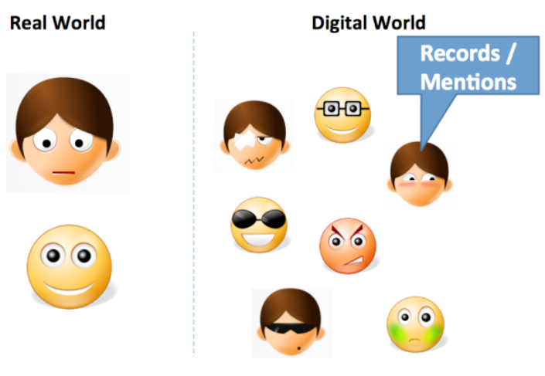
Entity Resolution / Co-Ref. resolution
Example: sameauthor(A,B)
:-sameauthor(A,C), sameauthor(C,B).
Example Dataset: ER_Cora
Entity resolved: sameauthor(authorRef, authorRef) [Or samebib, ..title, ..venue…]
RDN: java -jar BoostSRLRDN.jar -l -train data/ER_Cora/train -target sameauthor -trees 5 -i -test data/ER_Cora/test -aucJarPath ./
MLN: java -jar BoostSRLMLN.jar -l -train data/ER_Cora/train -target sameauthor -trees 5 -i -test data/ER_Cora/test -aucJarPath ./ -mln

Slide 8
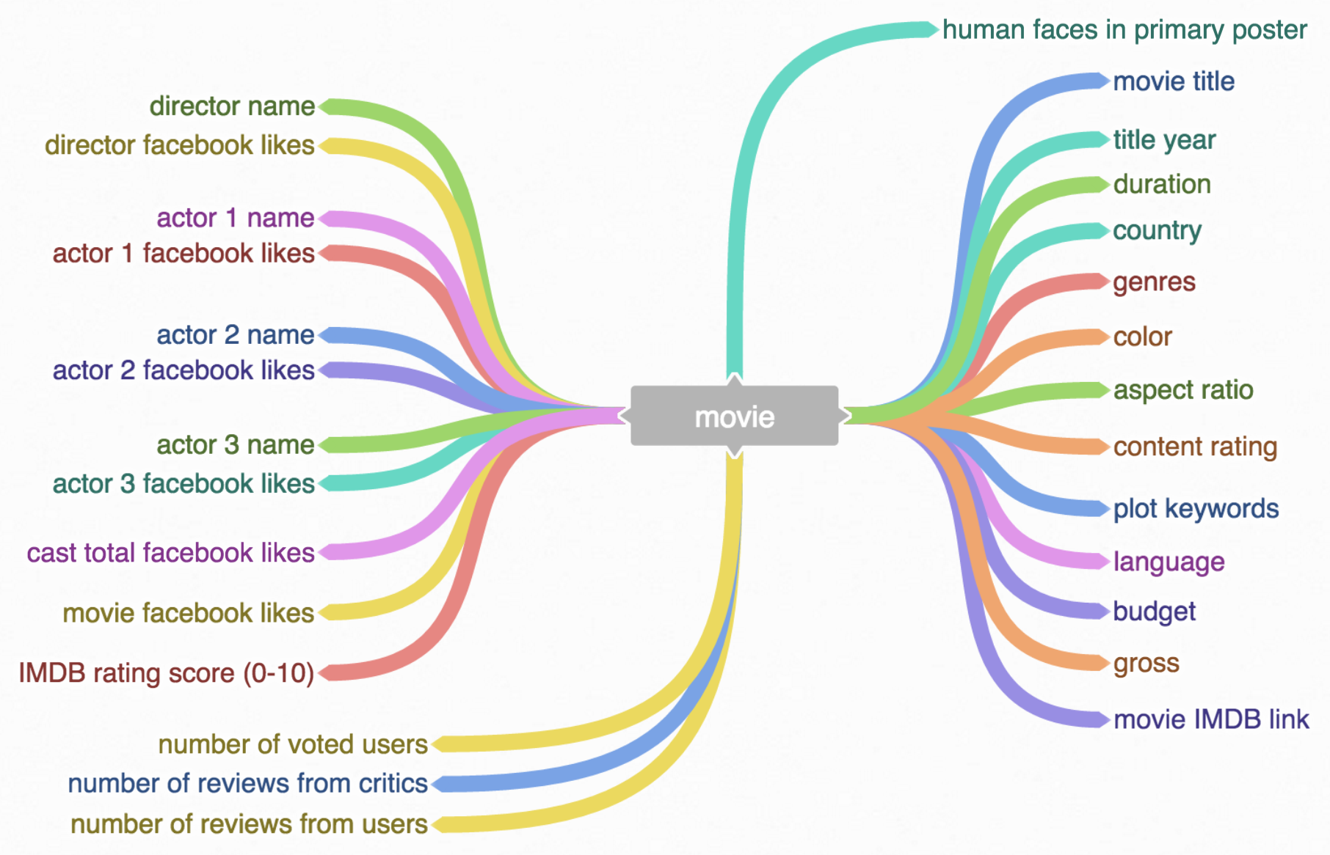
Attribute prediction
Example: rating(movie1)
:- director(movie1,person1), popularity(person1, “high”)
Dataset: AP_IMDB
Predicted attribute: female_gender(person) [or rating(movie) etc…]
RDN: java -jar BoostSRLRDN.jar -l -train data/AP_IMDB/train -target female_gender -trees 5 -i -test data/AP_IMDB/test -aucJarPath ./
MLN: java -jar BoostSRLMLN.jar -l -train data/AP_IMDB/train -target female_gender -trees 5 -i -test data/AP_IMDB/test -aucJarPath ./ -mln

Slide 9
Cost sensitive learning (Soft margin)
Controls trade off between False positive (FP) and False negative (FN) in relational domains
Example: Interacts(drug1,drug2)
:- EnzymeInhibitor(drug1, enzyme1), EnzymeInducer(enzyme1, drug2)
Example task/data set: Link prediction (RE_DDI, Interacts(drug, drug)) – here FN more harmful than FP → FN higher cost
Run Instruction:
java -jar BoostSRLRDN.jar -l -train data/RE_UW-CSE/train -target advisedby -trees 5 -i -test data/RE_UW-CSE/test -aucJarPath ./ -softm –alpha 0.7 –beta 0.3
Flag to invoke Cost sensitive learning
Weight on FN
Weight on FP

Slide 10
Approximate counting
For efficient learning/inference via approximate counting¹
Example: sameauthor(A,B) :-sameauthor(A,C), sameauthor(C,B).
For A=“Bob”; B=“Ava” #[sameauthor(“Bob”,C), sameauthor(C, “Ava”)] = 292 ~ 300
Example task/data set: Entity resolution (Cora; sameauthor())
Mandatory setting: For MLN learning
Run Instruction:
Learn: java -jar BoostSRLMLN.jar -l -train data/ER_Cora/train –models data/ER_Cora/train/model -target sameauthor -trees 5 -mln –approxCount
Infer: java -jar BoostSRLMLN.jar –models data/ER_Cora/train/model -i -test data/ER_Cora/test -aucJarPath ./ -target sameauthor -trees 5 -mln
Flag to invoke approximate counting
¹Das et al. SDM 2016

Slide 11
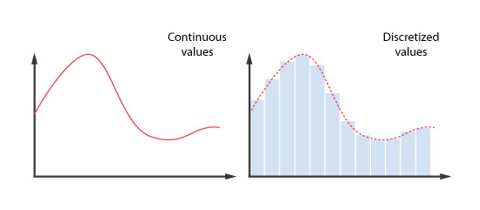
Discretization
Discretizes continuous valued predicate arguments into fixed bins
Example: Chol(P5,85.6), Chol(P1,90.7), Chol(P2,100.5)
Discretization info to be included in the background file as below
Example task/data set: Attribute prediction (from continuous features, Toy_HA [target: HeartAttack(person)])
Run Instruction:
java -jar BoostSRLRDN.jar -l -train data/Toy_HA/train -target HA -trees 3 -i –test data/Toy_HA/test -aucJarPath ./
Discretized predicates written to “train_facts_disc.txt” file in the location “data/Toy_HA/train”
Clusters close values into same bin; no. of bins set by user
disc: Chol ([2],[3])
indicator
Predicate to be discretized
(argument location, no. of bins)

Slide 12
Relational Random Walks
Aim: Obtain lifted random walks when relational data is represented as lifted graph where the nodes of the graph represent entity types and edges of the graph represent relations existing between two entities that it is connecting
Example task/data set: Attribute prediction (IMDB_RWalks)
Run Instructions:
java -jar LiftedRandomWalks.jar -rw -train "./data/IMDB_RWalks/imdb_bk.txt“ -startentity "person" -endentity "person" -maxRWlen 6
Output:
Final Random Walks Stored at: “data/IMDB_RandomWalks/RWRPredicates.txt”

